Slide 1
Operating System Fundamentals
Computer Engineering
Notes:
Introduction to the presentation on Operating System Fundamentals.

Slide 2
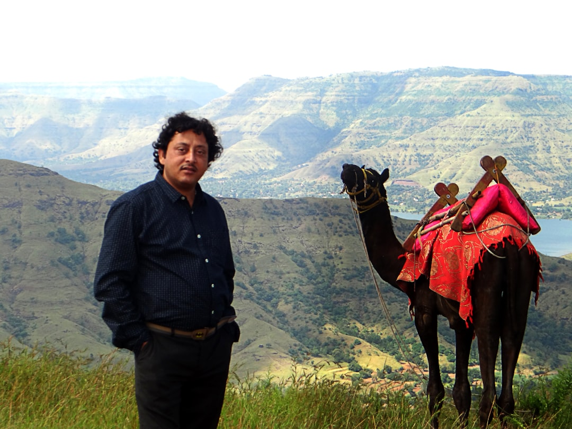
Introduction to Operating Systems
Operating systems manage computer hardware and software resources efficiently and effectively always
OS acts as an intermediary between user and computer hardware for better performance
Primary goal of OS is to provide a platform for running applications smoothly
Operating systems provide a layer of abstraction for hardware and software components
OS manages memory allocation and deallocation for running programs and services
Security features are implemented in OS to protect data and user information
Operating systems support multitasking and multithreading for increased productivity
Device management is a critical function of operating systems for hardware interaction
File system management is a key component of operating systems for data storage
Notes:
Present Introduction to Operating Systems in the context of Operating System Fundamentals.

Slide 3
Process Management Concepts
Notes:
Present Process Management Concepts in the context of Operating System Fundamentals.

Slide 4
Memory Management Techniques
Paging technique divides memory into fixed-size blocks for efficient allocation
Segmentation method divides memory into variable-size blocks for organization
Virtual memory uses secondary storage to supplement main memory capacity
Swapping technique involves exchanging pages between main and secondary memory
Memory fragmentation occurs when free memory is broken into small unusable blocks
Memory compaction technique rearranges memory to eliminate fragmentation and holes
First-In-First-Out replacement algorithm replaces oldest pages in memory
Least Recently Used replacement algorithm replaces least recently accessed pages
Priority-based replacement algorithm replaces pages based on priority levels assigned
Notes:
Present Memory Management Techniques in the context of Operating System Fundamentals.

